Slide 1

FILE MANAGEMENT SOFTWARE
Presented by: Batch-4
Swetha Devisetty - 46291226
Bhargavi Dumpa - 46290147
Rohitha Attili - 46290148
Adapa Devi Saranya - 46290149
Jyosna Sri Kalabattula - 46290150

Slide 2
Contents
Abstract
Introduction
Functional requirements
Technical Requirements
System Requirements
Flowchart
DFD Diagrams

Slide 3
Abstract
File Management software is mainly discuss about the connection establishment, server-client request response. The purpose of this document is to show the requirements for the File Management Software which maintains the files in the hard disk and the client provides menu-based interface for user to interact and upload/ download /add /delete files to the file management app.

Slide 4
Introduction
A file management software is an application that enables users to create, store and access files on a device like desktops or laptops. Initially file management systems were also designed to manage the files. E.g., WinSCP, FileZilla, Microsoft OneDrive. The user registration allows the user to register themselves to upload the files, files that are already uploaded can be downloaded after login. The add file allows the user to add title, description and upload the file in any of the supported formats. The delete file allows the user to delete files that we have uploaded. User can edit the description and details of our profile.

Slide 5
Functional requirements
The main functionalities which we done in this case study are:
Authentication with username and password.
Download files from server to local machine.
List the files.
Sends request to download a file.
Sends request to accept the file.
Sends request to delete a file.
Sends request to end the connection.

Slide 6
Functional requirements
Connection establishment.
Storing the downloaded files.
Display the files.
Uploaded a file in server.
Sends request to download a file.
Disconnect the connection.

Slide 7
Technical requirements
The technical requirements which we need in this case study are:
Process Synchronization
Shared memory in Linux
Socket Programming in C- TCP
Support for statistics
I/O Multiplexing
Logging and debugging framework

Slide 8
System Requirements
Software Requirements:
Operating System - Windows 11
Server-side script - C Language
IDE - Putty
Libraries used - C libraries

Slide 9
System Requirements
Hardware Requirements:
Processor - i5/Intel Processor
RAM - 4GB (min)
Hard Disk - 128 GB
Keyboard - Standard Keyboard
Mouse - Two or three button mouse

Slide 10
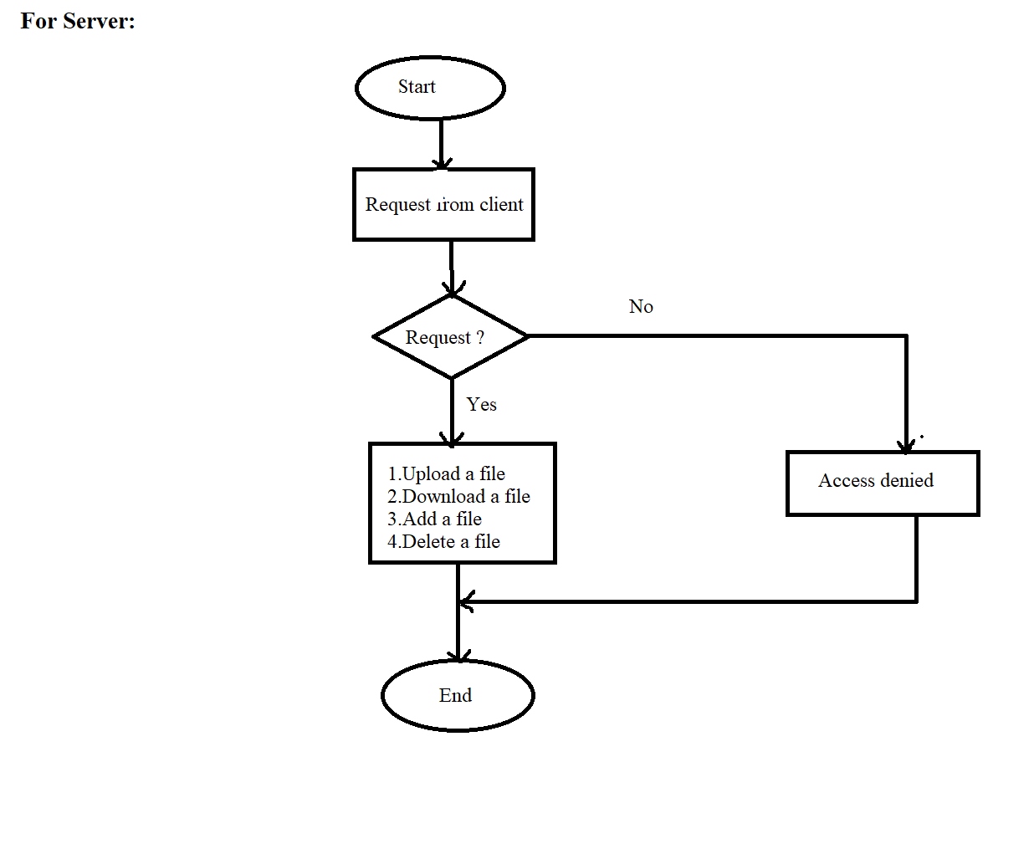
Flow chart
Server Side:
nbnmbnmbnmbnmbm

Slide 11
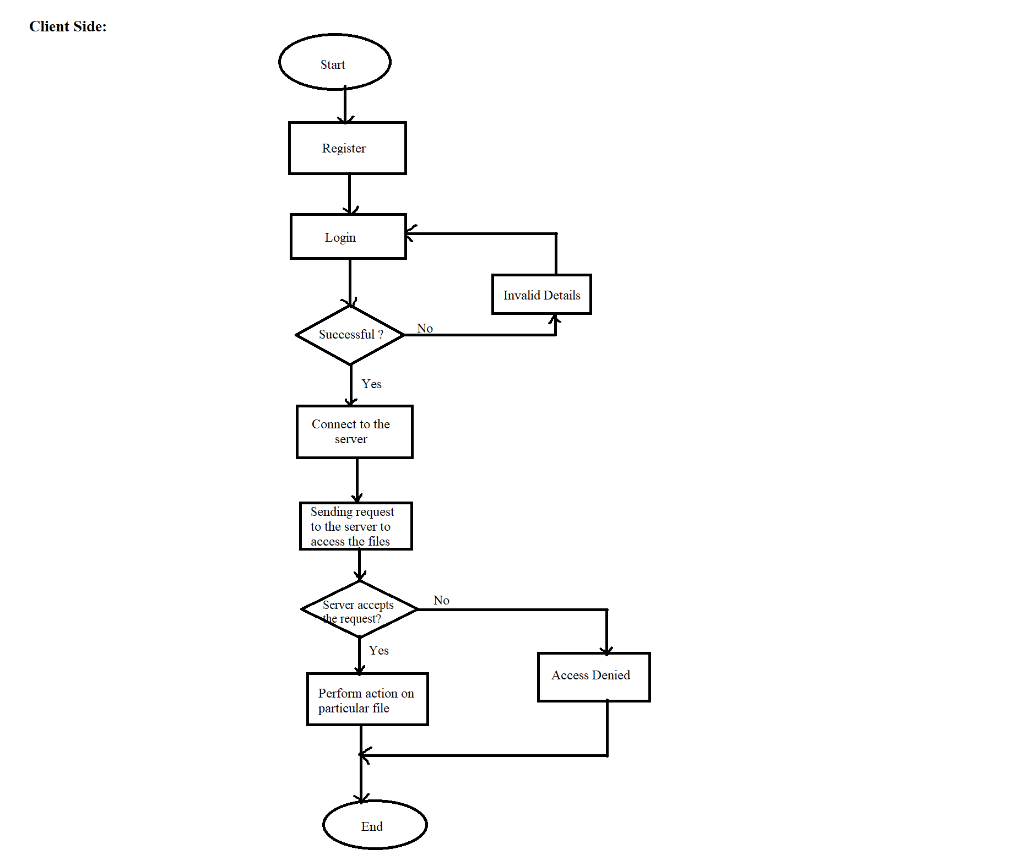
Flow chart

Slide 12
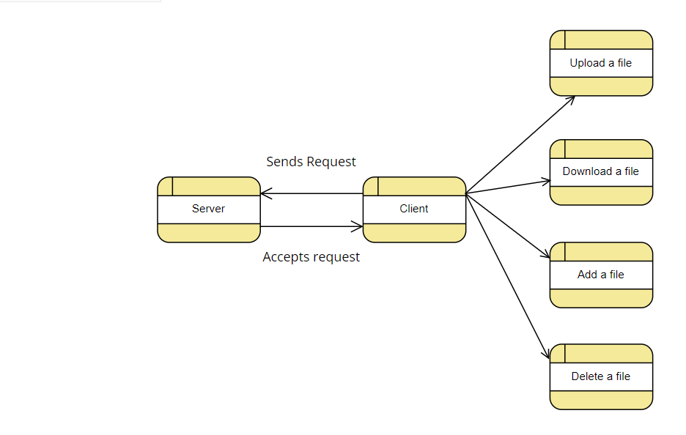
DFD Diagrams
DFD Level 0:

Slide 13
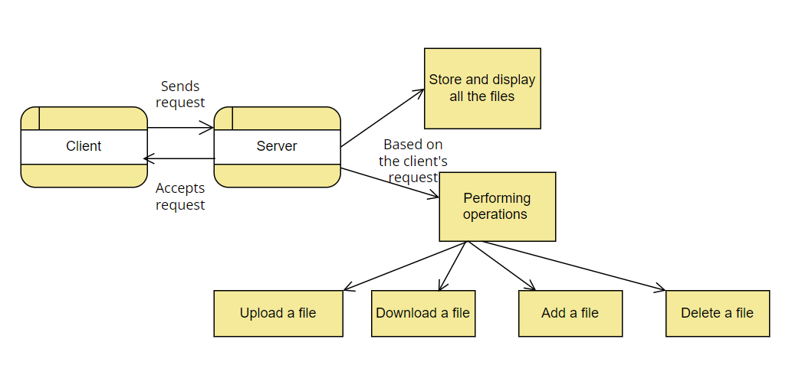
DFD Diagrams
DFD Level 1:

Slide 14
THANK YOU

